Slide 1
Think Like A Cloud Developer
Jeff Putz

Slide 2
About Me
Code monkey since 1999-ish (formerly a top-40 DJ, pays as poorly as you think)
Mostly a MSFT stack guy these days, but a “web guy” since before it was cool.
Can’t get away from forums… author of POP Forums, worked on MSDN Forums.
Run a site for roller coaster nerds called CoasterBuzz.
Currently: Technical Architect at AgileThought.
Previously: SeaWorld Parks & Entertainment, Humana, Microsoft, Insurance.com, many contract gigs

Slide 3


Slide 4
Agenda
Spinning up components that are meant to be thrown away.
When and how to work asynchronously.
Scale up vs. out.
The difference between PaaS and IaaS.
Exploring the toolbox.
Instrumentation to save the day.
Migrating your app to the cloud.
The new budgetary realties of using cloud services.

Slide 5


Slide 6
Spinning up components that are meant to be thrown away
The biggest change in thinking revolves around the idea that instances of code running in the cloud are stateless and disposable.
The hardware is all virtual. It’s intended to be allowed to fail.
Stuff in memory or the file system is not durable.
When you scale out, there are potentially many instances that don’t know anything about each other.

Slide 7
Spinning up components that are meant to be thrown away
So if I can’t use memory or disks, now what?
State is best stored in shared resources: Databases, distributed cache, external services, etc.
Not being dependent on a durable instance of running code frees you to run multiple instance for redundancy, load balancing, geo-distributed instances, etc.
You can delegate hard work to non-Web “servers” via queues, message busses, etc.

Slide 8
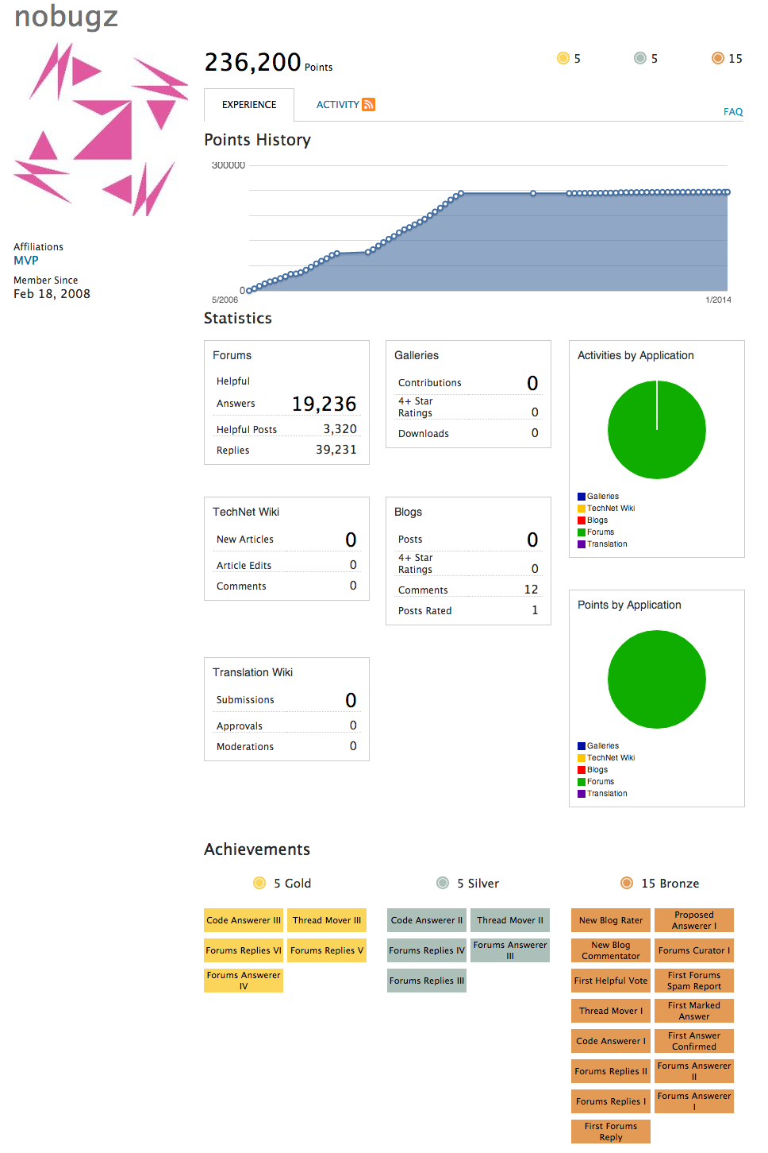
When and how to work asynchronously
Sometimes, you don’t need the result of some work right now.
Even a couple of seconds later is “good enough” in many cases.

Slide 9
When and how to work asynchronously
API
⬇
Processing Queue
⬇
Event Router
⬇
Event specific queue
⬇
Event Processor
⬇
Event Publisher
➡ Calculation Queue
⬇
Award Calculator

Slide 10
When and how to work asynchronously
Use this when eventual consistency is OK. Indexing a blog post for search, you can probably wait on (this is called eventual consistency). Updating the balance of a bank account, not so much.
You already understand async between browsers and servers, so extend that thinking to cloud tools.
Use message queues for first in, first out data/event processing. Ideal for one-time action per message.
Use a service bus when you need multiple subscribers responding to events. (Think of an event that must be broadcast to many web instances with listening SignalR clients.)

Slide 11
Scale up vs. out
Scale up: Make your virtual piece of infrastructure run faster with more “CPU” and memory.
Ideal when your app is simply battling a memory ceiling.
CPU and memory are often helpful for database scaling.
Doesn’t change the complexity of the app design.
Scale out: Spin up more instances of different app components to spread out the workload.
Enables redundancy.
Makes geo-distributed work loads possible.
Definitely requires the “disposable instance” approach mentioned previously.

Slide 12
Platform as a Service (PaaS)
vs.
Infrastructure as a Service (IaaS)

Slide 13
The difference between PaaS and IaaS
Infrastructure as a Service (IaaS) is largely the virtual version of what you’ve been using for years.
Servers, networks, “disks,” load balancers, etc.
Virtual machines in particular still require all of the normal maintenance of “real” servers.
VM’s still need to be set up with all of the stuff you want them to have (the good news: this can be automated).
Because these resources are analogous to a traditional rack of durable equipment, they’re a great intermediate step to cloud adoption. Your existing stuff will run here.
Provisioning is near instant, especially compared to non-virtual hardware.

Slide 14
The difference between PaaS and IaaS
Platform as a Service (PaaS) offerings are often use case-specific and extract away operating systems, maintenance, redundancy and other details.
Ideal for the spin it up, tear it down scenario.
You often get redundancy for “free” and don’t need to know about or understand the underlying infrastructure.
Apps may need some level of modification to run in multiple instances and take advantage of scale out.
Different resources may be cheaper because of different pricing and service models (i.e., a queue may be priced by millions of messages, which is different from needing a physical server to host the queue).

Slide 15
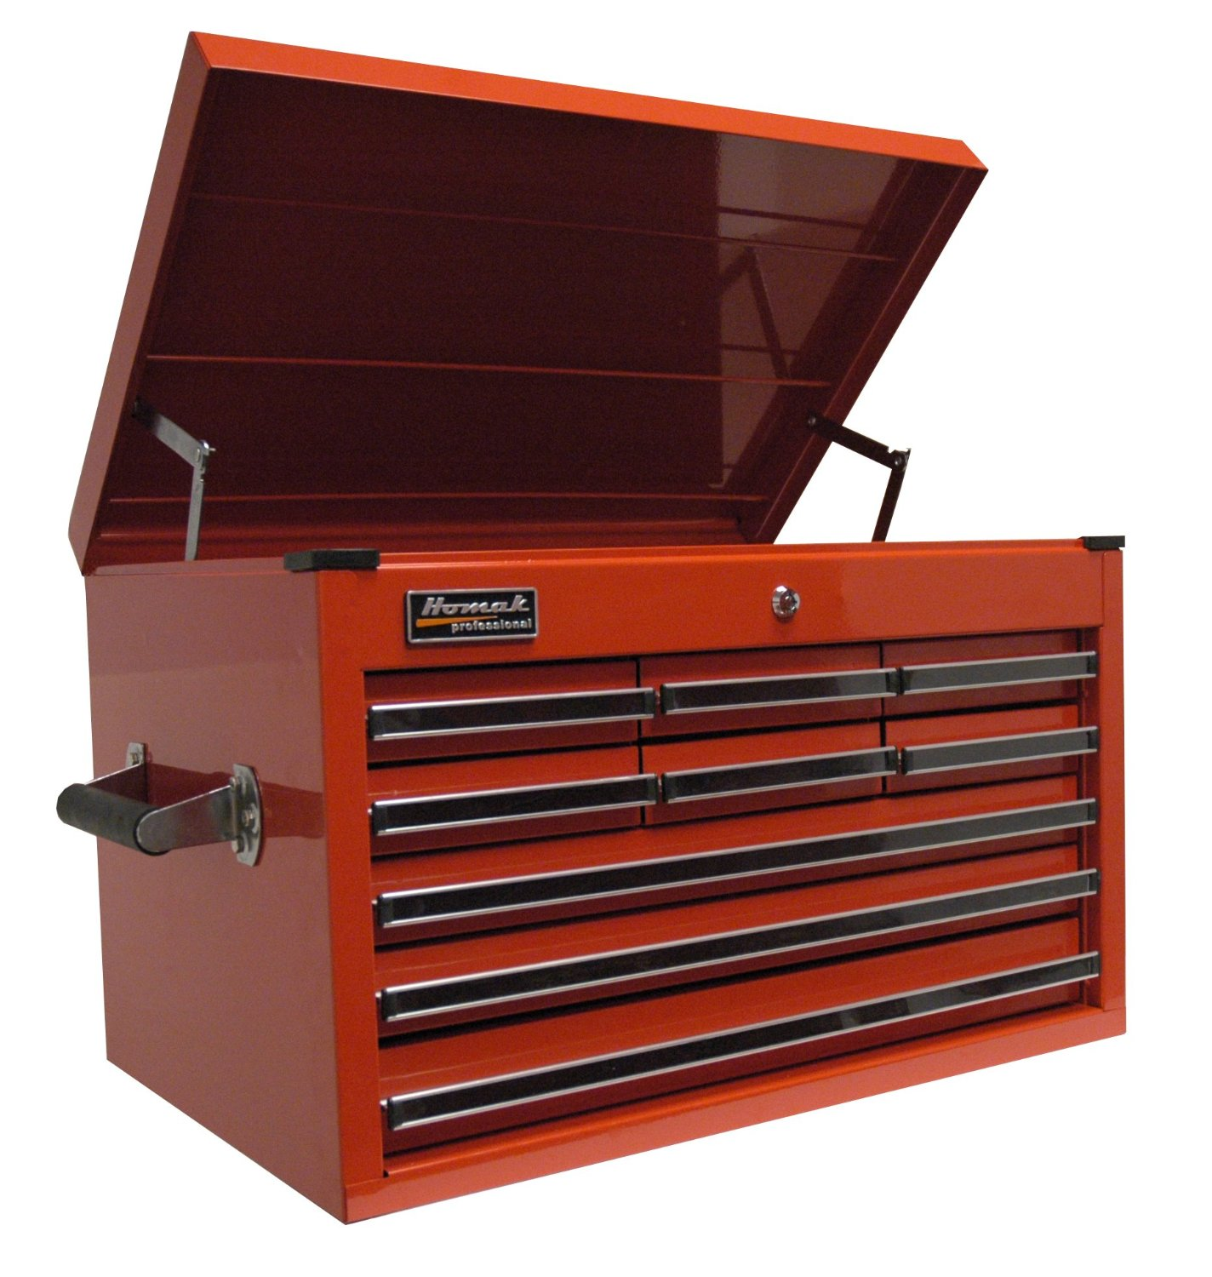

Slide 16
Exploring the toolbox
Virtual machines: Durable like servers, only virtualized.
Websites: HTTP listening apps (Azure just renamed these “Web Apps”).
Platform compute instances: Azure- Cloud Services, AWS- Containers.
Periodic execution: Azure- Webjobs in Web Apps, AWS- Lambda.
Storage: Tables, blobs, virtual disks, etc.
Messaging: Queues, service bus.
CDN: Content delivery network.
Data: Relational databases, caches, documents.
Reporting, OLAP, Hadoop, etc.
Virtual networking and dedicated connections.

Slide 17
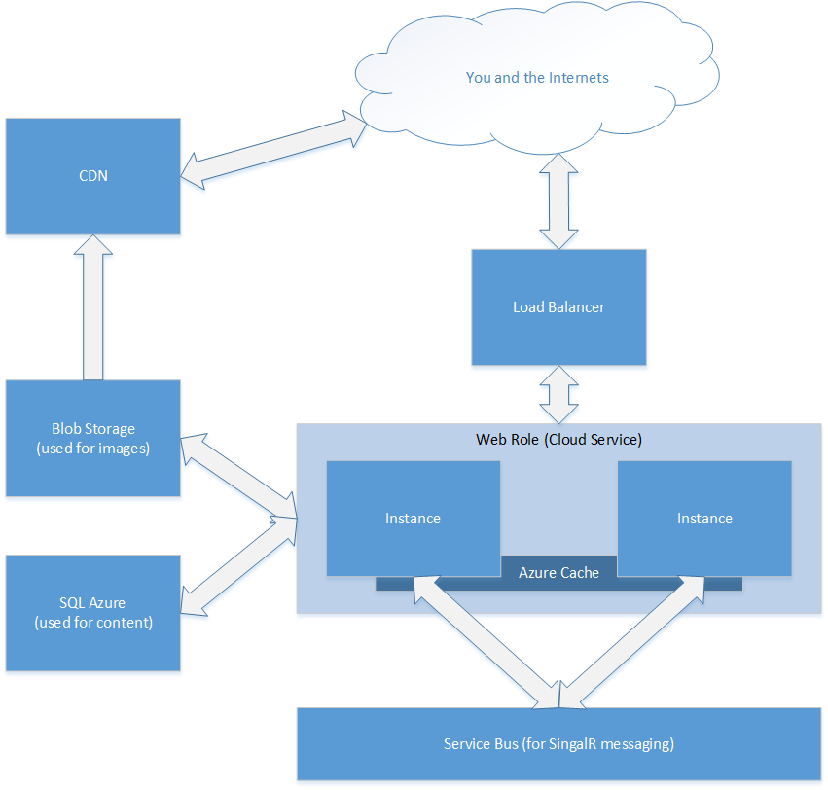
Exploring the toolbox
liveblog.codeplex.com

Slide 18


Slide 19
Instrumentation to save the day
Nothing has more context about its environment than the thing running in it.
Find failures and performance issues by measuring the interactions between systems and components. Record latency and connection failures. Dashboard it.
Share common identifiers across interactions. If Process A send a message through Queue B and Database C has something unexpected, follow the trail.
Use the cloud vendor’s statistics and visualization tools to understand if you’re battling a resource constraint.

Slide 20
Migrating your app to the cloud
A VM is just a lateral move, but it gets you out of a traditional data center.
Taking advantage of cloud resources requires that you remove the constraints that limit the aforementioned “disposable” nature of the platform. (In other words, lose dependencies on file systems, local memory, etc.)
Embrace asynchronous pipelines from the browser all the way up through the stack.

Slide 21
The new budgetary realties of using cloud services
The price/performance curve finally favors the cloud for all but the smallest of projects.
It keeps getting cheaper.
Buying hardware was already too expensive, but even renting it is, by comparison, inefficient.
You often get certain things for “free” when using the cloud (backups, data redundancy, identity providers, networking, load balancers).
Automation allows you to address capacity needs. If you need 4 instances of an app a noon, and 1 at midnight, you only pay for what you need.
A massive deployment of resources used only for a day or two may only cost you a few $20 bills.

Slide 22
Questions?

Slide 23
Find me
http://weblogs.asp.net/jeff
jeff@popw.com
@jeffputz
Open source: http://popforums.com

